Slide 1
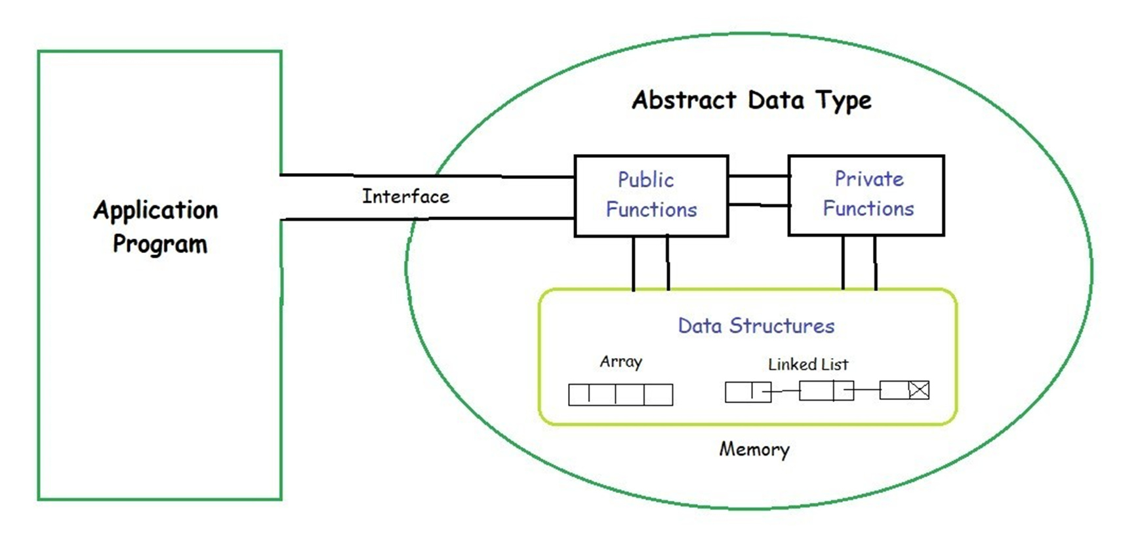
Introduction to Data Structures
Created by P.Harsha Vardhini
217Z1A6744
Data structures are the fundamental building blocks of computer programming. They provide efficient ways to organize and manage data, enabling developers to create powerful and scalable applications. This presentation will explore the key data structures used in computer science, their characteristics, and practical applications.

Slide 2

Introduction to Data Structures
Data structures are the fundamental building blocks of computer programming. They provide efficient ways to organize and manage data, enabling developers to create powerful and scalable applications. This presentation will explore the key data structures used in computer science, their characteristics, and practical applications.

Slide 3

Arrays
Definition
Operations
Use Cases
Arrays are ordered collections of elements, all of the same data type, stored in contiguous memory locations.
Arrays support efficient access, insertion, and deletion at specific indices, making them suitable for a wide range of applications.
Arrays are commonly used for storing and processing large amounts of data, such as in image processing, scientific computing, and database management.

Slide 4
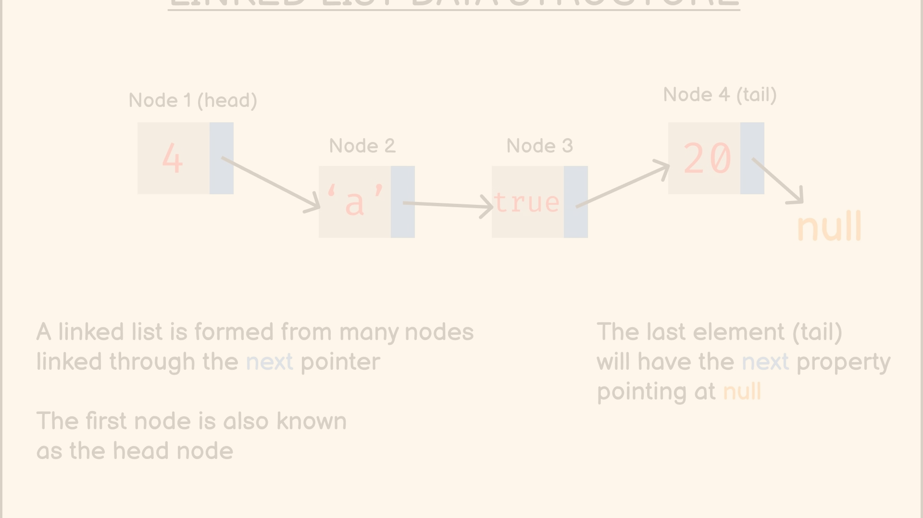



Linked Lists
Concept
Flexibility
Applications
Linked lists are a dynamic data structure where each element (node) contains data and a reference (link) to the next node in the sequence.
Linked lists allow for efficient insertion and deletion at any point in the list, unlike arrays, which have fixed sizes.
Linked lists are widely used in implementing stacks, queues, and other data structures, as well as in memory management and network routing.

Slide 5
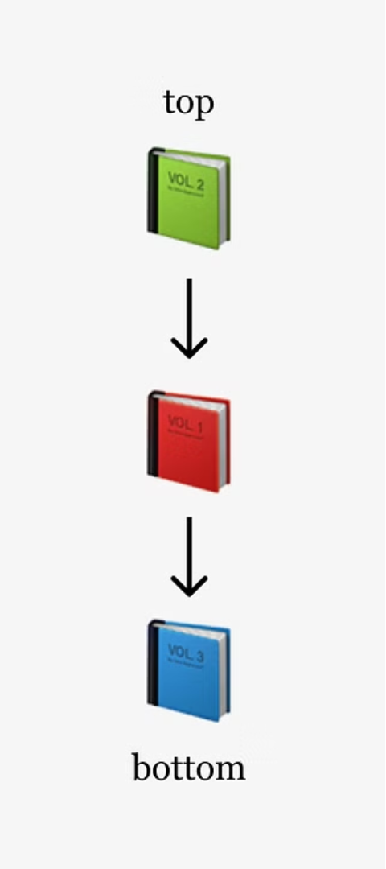
Stacks
Definition
Operations
Stacks are a Last-In-First-Out (LIFO) data structure, where elements are added and removed from the top of the stack.
Stacks support push (add), pop (remove), and peek (access the top element) operations, making them useful for managing function calls, expression evaluation, and undo/redo operations.
Applications
Stacks are commonly used in web browsers for navigating back and forth between pages, in compilers for managing function calls, and in programming language implementations.

Slide 6



Queues
Enqueue
Dequeue
Peek
Adding an element to the back of the queue.
Removing an element from the front of the queue.
Accessing the element at the front of the queue without removing it.

Slide 7
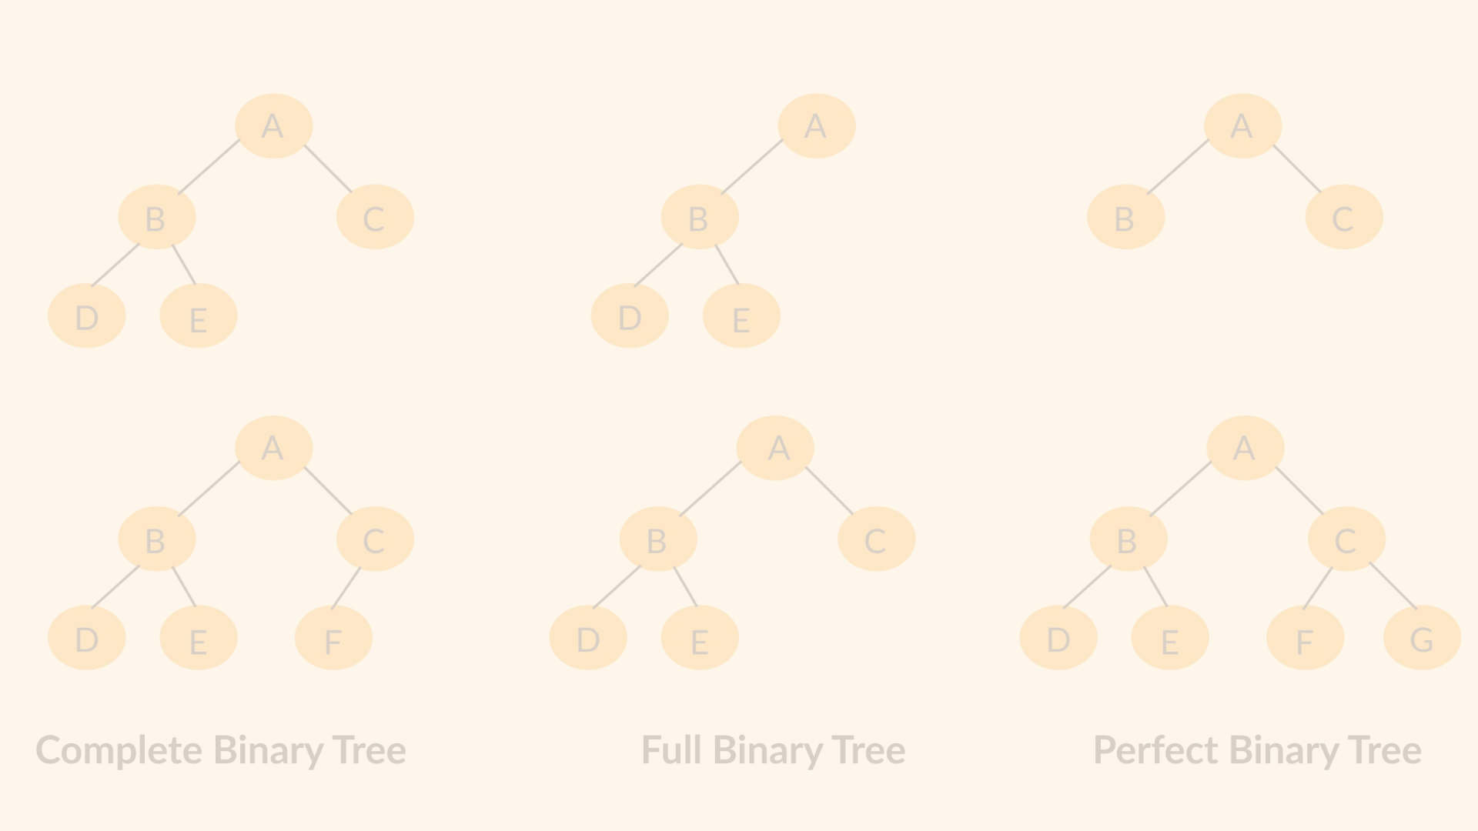
Trees
Hierarchical Structure
1
Trees are a non-linear data structure that organizes data in a hierarchical manner, with a root node and child nodes.
2
Traversal Algorithms
Trees can be traversed using various methods, such as in-order, pre-order, and post-order, to access the nodes in a specific order.
Applications
3
Trees are used in file systems, decision-making algorithms, expression parsing, and more, taking advantage of their efficient navigation and searching capabilities.

Slide 8
Graphs
1
Vertices and Edges
2
Traversal Algorithms
Graphs are made up of vertices (nodes) and edges (connections) between them, representing relationships between data.
Graphs can be traversed using algorithms like Depth-First Search (DFS) and Breadth-First Search (BFS) to explore the connections between nodes.
3
Applications
Graphs are used in social networks, road maps, recommendation systems, and more, allowing for the modeling of complex relationships and networks.

Slide 9
Conclusion and Key Takeaways
Understand the fundamental data structures
Appreciate their unique characteristics and use cases
Develop problem-solving skills by applying the right data structure
Recognize the importance of data structures in building efficient and scalable applications
Continuously expand your knowledge and explore advanced data structures
Apply data structures to solve real-world problems in fields like computer science, engineering, and finance

